Slide 1
AMAZON SALES & BUSINESS PERFORMANCE
A Data Analyst Case Study
SQL data cleaning & analysis • Excel MIS reporting • Power BI dashboarding
Dhanush Narla
Analysis Period: Jan 2023 – Dec 2025 | Dataset: amazon_sales_dataset (synthetic)

Slide 2
BUSINESS REQUIREMENTS
The Business Problem
Management needed one consolidated view of sales, profitability, customer behaviour, product performance, geography, delivery outcomes, and returns — spread across raw transactional data with no single source of truth.
1
2
Revenue & Profit
Customers
What drives sales and margin?
Who buys, and how often?
The goal: turn a messy raw export into validated, decision-ready insight — and give management a single dashboard to act on.
3
4
Operations
Returns
How well do we deliver?
Why are orders coming back?
2

Slide 3
BUSINESS REQUIREMENTS
Objectives & Scope
Clean and validate the raw dataset
Measure overall sales, profit & profitability
Analyze monthly sales and margin trends
Identify top categories, products & cities
Compare customer segments & value tiers
Evaluate delivery, returns & cancellations
Build an Excel MIS + Power BI dashboard
SCOPE AT A GLANCE
25,000
Unique orders analyzed
36
Months of data (2023–2025)
3
Tools: SQL • Excel • Power BI
Financial analysis covers Delivered orders only; operational analysis covers all order statuses.
3

Slide 4
METHODOLOGY
End-to-End Workflow
1
→
2
→
3
→
4
→
5
→
6
→
7
Raw
Dataset
SQL Profiling,
Cleaning &
Validation
Cleaned
Dataset
SQL Business
Analysis
Excel MIS
Reconciliation
Power BI
Dashboard
Insights &
Recommendations
Every stage feeds the next: SQL establishes a single validated source of truth, Excel reconciles the headline KPIs by hand, and Power BI turns the validated numbers into something management can explore on their own.
4

Slide 5
DATA QUALITY, CLEANING & VALIDATION
From Raw Export to Trusted Dataset
Area | Issue Identified | Resolution
Raw records | 25,250 rows loaded | 250 exact duplicates found → removed
Unique orders | 25,000 confirmed | Deduplicated and validated as the analysis base
Return reason | 89 blanks on returned orders | Retained as NULL — reason genuinely unknown
Category / Payment | Inconsistent casing & spacing | Standardized to a single clean label set
Business rules | Sales, cost, profit vs. status | Verified: Delivered > 0, Returned/Cancelled = 0
Data-quality work was completed before any business analysis — not only to remove incorrect records, but to test whether blank, zero, or negative values reflected genuine business outcomes.
5

Slide 6
HEADLINE PERFORMANCE
The Business at a Glance
25,000
19,450
₹309.96M
₹105.02M
Total Orders
Delivered Orders
Total Sales
Total Profit
33.88%
11.98%
10.22%
8,448
Profit Margin
Return Rate
Cancellation Rate
Total Customers
6

Slide 7
SQL BUSINESS ANALYSIS
Revenue Is Concentrated In Two Categories
72.2%
of delivered sales come from Electronics + Furniture alone
Top products (each ₹12.59M–₹17.70M in sales):
Office Chair, Study Table, Sofa Set, Wardrobe, Wooden Bookshelf, Bed Frame, Smartphone, Laptop, Bluetooth Speaker, Router
A stock-out or supplier delay in either top category would hit total revenue disproportionately hard.
7

Slide 8
SQL BUSINESS ANALYSIS
New Customers Drive Volume, Frequency Drives Depth
New customers currently generate more orders, sales and profit than Returning customers — the business leans on acquisition more than repeat purchasing. Occasional buyers are the single largest segment, ahead of Frequent, One-Time and Highly Frequent combined.
8

Slide 9
SQL BUSINESS ANALYSIS
Value Is Heavily Concentrated in Regular
5,271
Regular customers — the largest tier by headcount, and by far the largest by value
Losing even a small share of Regular customers would materially damage overall profit — retention here matters more than anywhere else.
9

Slide 10
SQL BUSINESS ANALYSIS
Higher Sales Don't Always Mean Higher Margin
₹133.41M
in sales came with zero discount — and the best margin of any band, 39.32%
₹137.48M
in sales came from the Very High Discount band — similar revenue, but margin fell to 29.70%
Discounting decisions should be judged on margin, not on the size of the sales number they produce.
10

Slide 11
SQL BUSINESS ANALYSIS
1 in 5 Orders Never Convert to Revenue
No single return reason dominates — the top cause (Defective Product) is just 11.8% of recorded returns, with the rest spread almost evenly across pricing, fit, fulfilment, and delivery issues. This points to a broad, systemic issue rather than one fixable root cause.
11

Slide 12
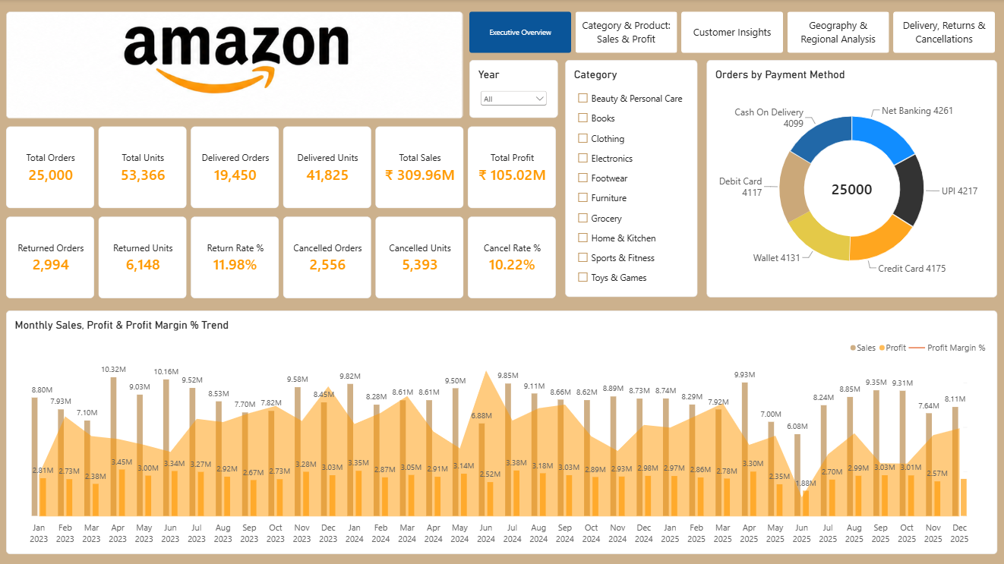
POWER BI DASHBOARD
One Interactive Dashboard, Five Views
12

Slide 13
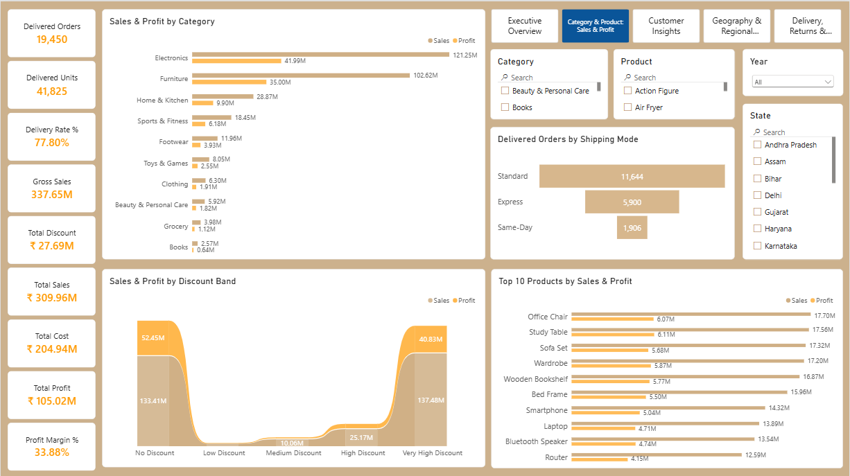
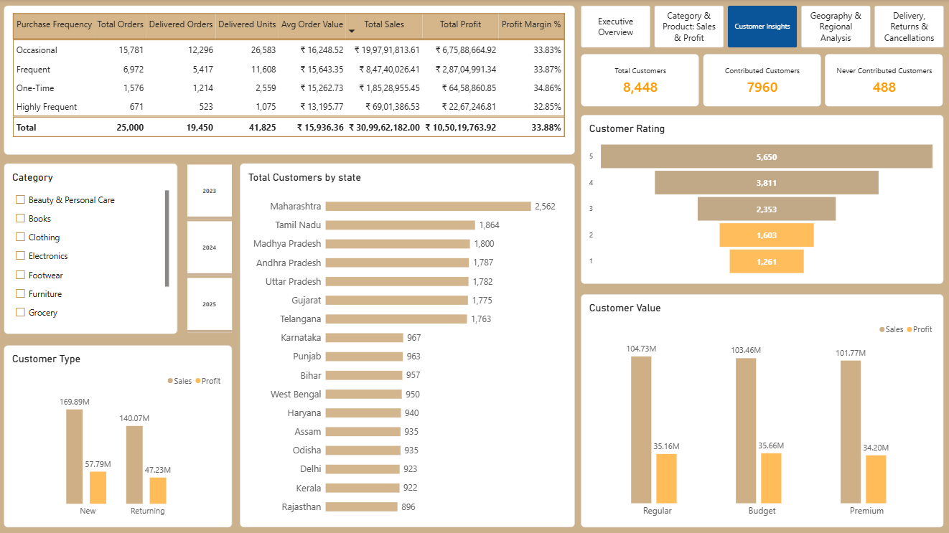
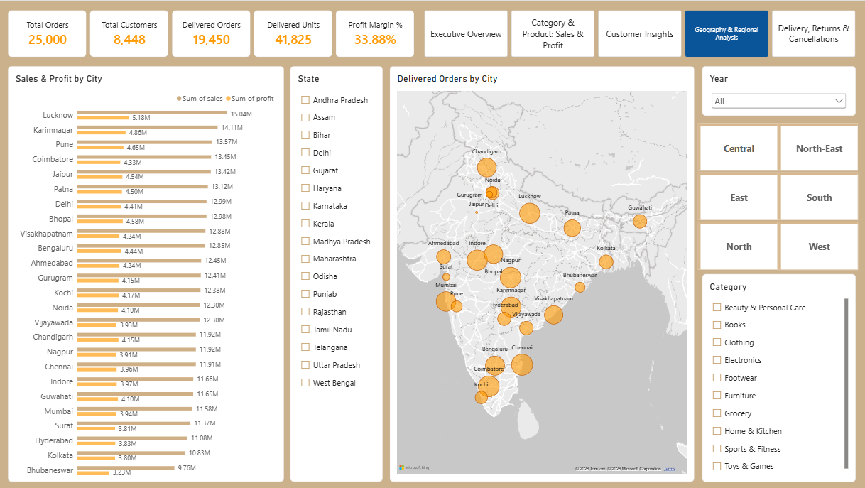
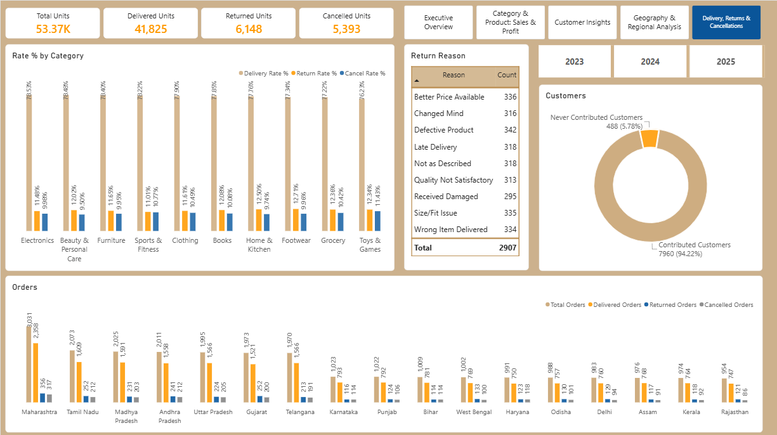
POWER BI DASHBOARD
Four More Pages Behind the Executive View
Category & Product: Sales & Profit
Customer Insights
Geography & Regional Analysis
Delivery, Returns & Cancellations
13

Slide 14
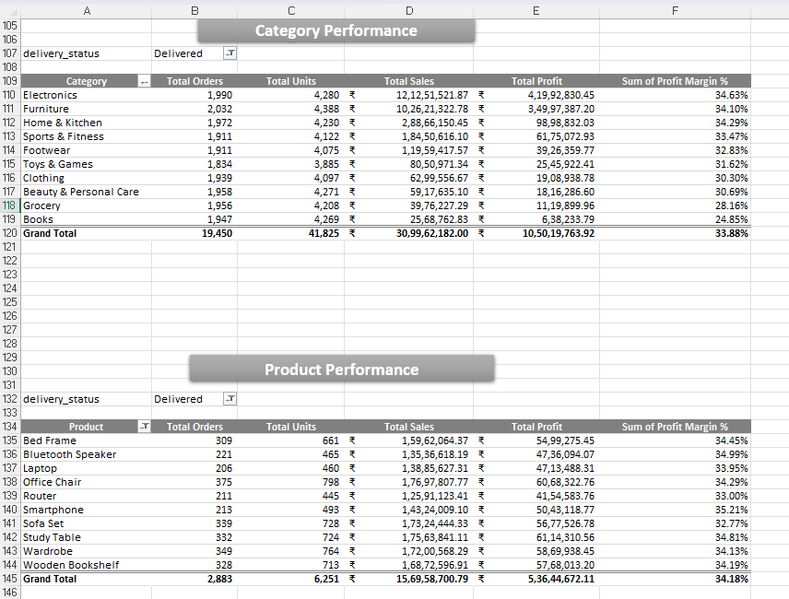
EXCEL MIS & VALIDATION
Reconciled Independently in Excel
Why reconcile twice?
SQL produces the analysis; Excel independently re-derives the same KPIs using pivot tables. If the two don't match, something in the pipeline is wrong.
Result:
Category, product, and headline KPI totals reconcile exactly between SQL and Excel — confirming the analysis logic is consistent across tools.
14

Slide 15
RECOMMENDATIONS
What Management Should Do Next
1
Protect high-value categories
Prioritize inventory, supplier reliability and margin protection for Electronics and Furniture.
2
Convert occasional buyers into repeat customers
Post-purchase offers, loyalty rewards and personalized recommendations to shift the New→Returning balance.
3
Reduce returns by root cause
No single cause dominates — fix quality, fulfilment, sizing and descriptions in parallel, not one at a time.
4
Judge discounts on margin, not sales
Set category-level margin thresholds and test discount depth against actual profit impact.
5
Protect Premium customers above all else
This tier drives 93% of profit — retention here outweighs almost any other initiative.
15

Slide 16
CONCLUSION
An End-to-End Data Analyst Workflow
This project demonstrates a complete analyst workflow: SQL to profile, clean and validate; SQL again for detailed business analysis; Excel to reconcile the numbers independently; and Power BI to put it all in front of decision-makers. The business is profitable at a 33.88% margin — but revenue concentration, return/cancellation rates near 22%, and profit riding almost entirely on Premium customers are the areas that deserve the next round of attention.
Dhanush Narla
Aspiring Data Analyst
dhanushnarla5@gmail.com
LinkedIn
SQL (CTEs, joins, validation)
GitHub
Excel (pivot tables, MIS reconciliation)
Power BI (DAX, dashboard design)
Data cleaning & QA
Business storytelling
16

